Slide 1
Machine Learning
Lecture 10: Bias-Variance Tradeoff
Dr. Beilun Wang
Southeast University
School of Computer Science
and Engineering

Slide 2
Course Content Plan
Regression (supervised)
Classification (supervised)
Unsupervised models
Learning theory
Y is a continuous
Y is a discrete
NO Y
About f()
Graphical models
About interactions among X1,… Xp
Reinforcement Learning
Learn program to Interact with its environment

Slide 3
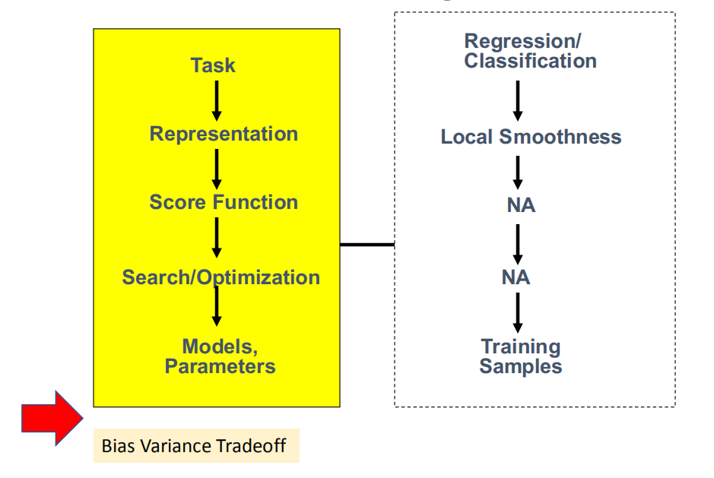
Today: Bias-Variance Tradeoff

Slide 4
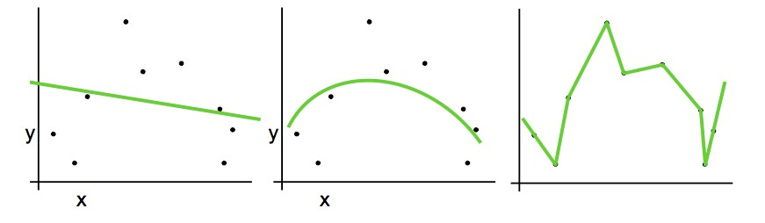
Previous in Regression: Complexity versus Goodness of Fit
What ultimately matters: Generalization

Slide 5
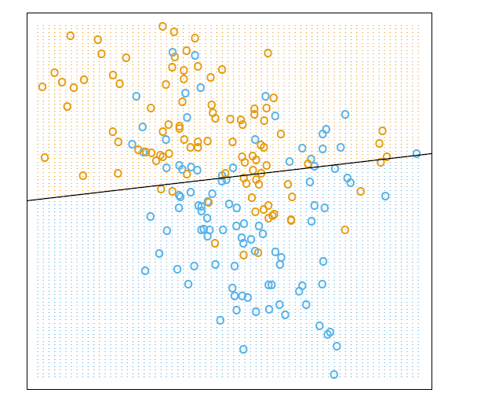
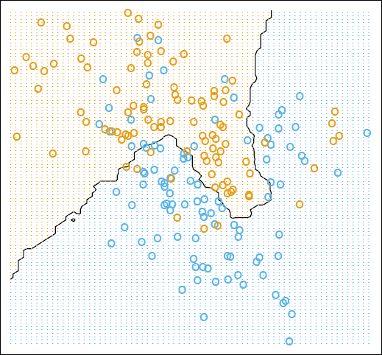
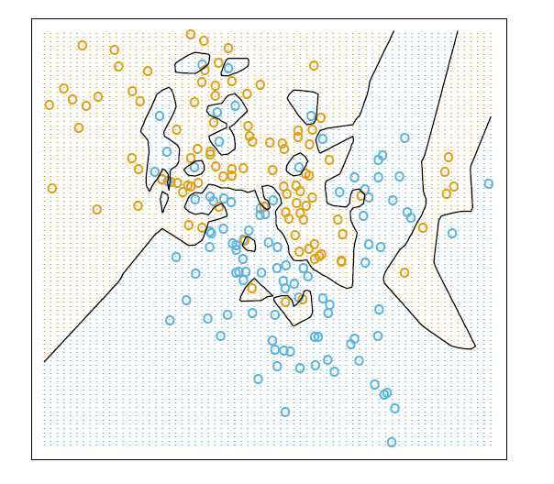
Last: Decision boundaries in Linear vs. KNN models
K=15
K=1
Linear classification
15-nearest neighbor
1-nearest neighbor
global
stable
can be inaccurate
K acts as a smoother
local
accurate
unstable
What ultimately matters: Generalization

Slide 6
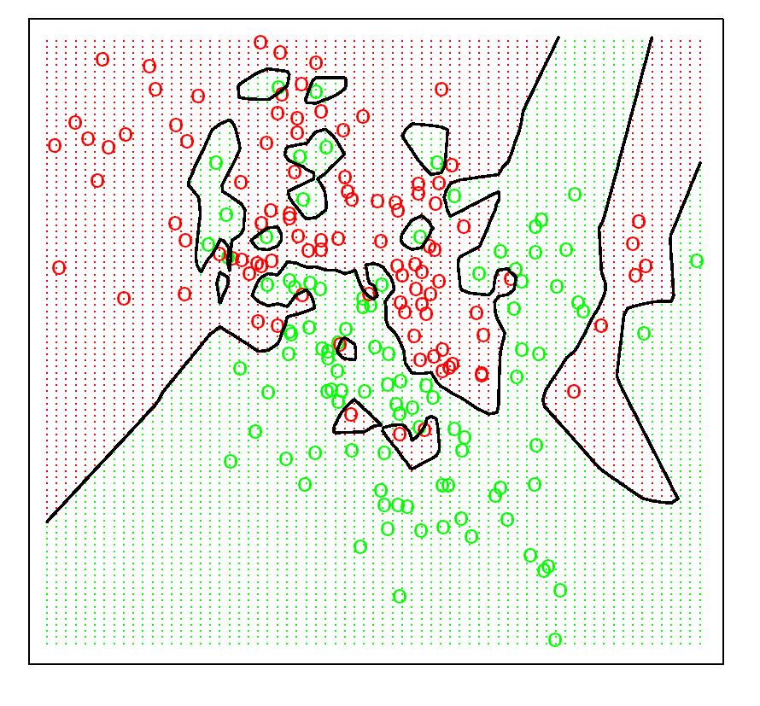
Lesson Learned: Training Error from KNN
1-nearest neighbor averaging
Minimizing training error is not always good
When k = 1, overfit
Y^{ˆ} > 0.5
Y^{ˆ} = 0.5
Y^{ˆ} < 0.5
X₁
X₂

Slide 7
Today
Bias-variance decomposition
Bias-Variance Tradeoff / Model Selection

Slide 8
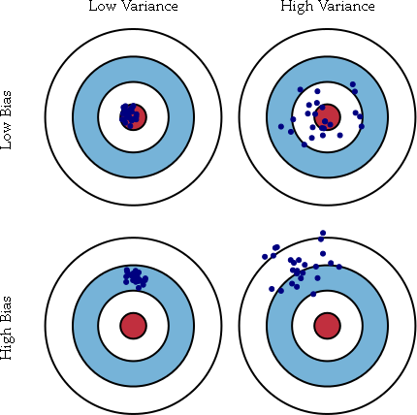


Model ‘bias’ & Model ‘variance’
Middle RED:
True function
Error due to bias:
How far off in general from the middle red
$$E[(\overline{θ}−θ)]$$
Error due to variance:
How wildly the blue points spread
$$E[(\hat{θ}−\overline{θ})^{2}]$$
Notes:
1

Slide 9
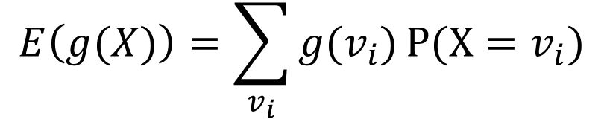
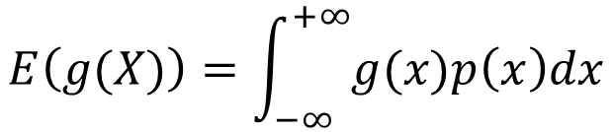
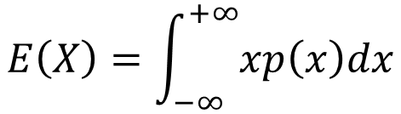
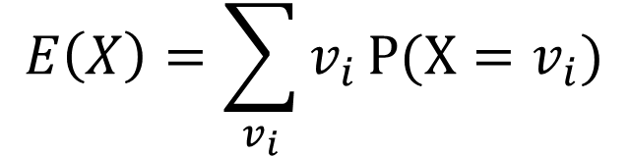
Review: Mean and Variance of Random Variable (RV)
Mean (Expectation):
Discrete RVs:
Continuous RVs:
$$E\left(X\right)=\sum_{v_{i}}{v_{i}}P(X=v_{i})$$
$$E\left(g(X)\right)=\sum_{v_{i}}{{g(v}_{i})}P(X=v_{i})$$
$$E\left(X\right)=\int_{−∞}^{+∞}{xp\left(x\right)dx}$$
$$E\left(g(X)\right)=\int_{−∞}^{+∞}{g(x)p\left(x\right)dx}$$
Adapt From Carols’ prob tutorial

Slide 10
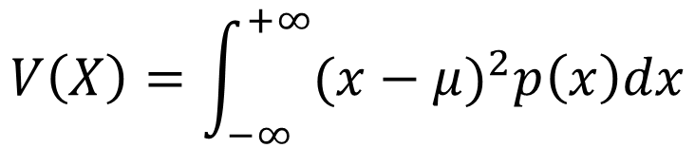
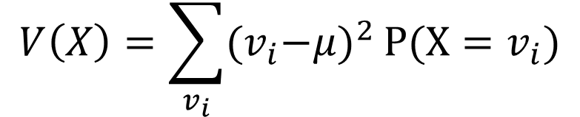
Review: Mean and Variance of Random Variable (RV)
Variance:
Discrete RVs:
Continuous RVs:
$$Var\left(X\right)=E(\left(X−μ)^{2}\right),μ=E(X)$$
$$V\left(X\right)=\sum_{v_{i}}{{(v}_{i}−μ)^{2}}P(X=v_{i})$$
$$V\left(X\right)=\int_{−∞}^{+∞}{(x−μ)^{2}p\left(x\right)dx}$$
Adapt From Carols’ prob tutorial

Slide 11
Statistical Decision Theory
Random input vector: X
Random output variable: Y
Joint distribution: Pr(X,Y )
Loss function L(Y, f(X))
Expected prediction error (EPE):
EPE( f ) = E(L(Y, f (X ))) = ∫ L(y, f (x))Pr(dx, dy)
e.g. = ∫ (y − f (x))² Pr(dx,dy)
Consider population distribution
e.g. Squared error loss (also called L2 loss)

Slide 12


Test Error to EPE
$$μ_{2}$$
$$μ_{1}$$
Random input vector: X
Random output variable:Y
Joint distribution: Pr(X,Y )
Loss function L(Y, f(X))
Expected prediction error (EPE):
smaller loss
bigger loss
EPE( f ) = E(L(Y, f (X ))) = ∫ L(y, f (x))Pr(dx, dy)
e.g. = ∫ (y − f (x))² Pr(dx,dy)

Slide 13
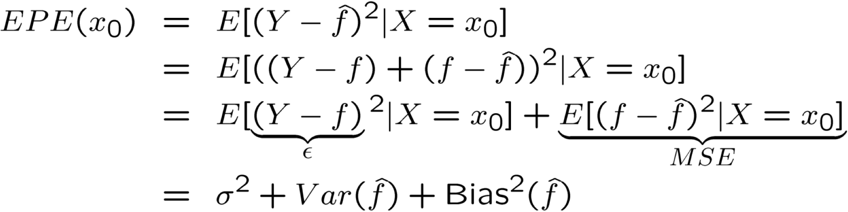
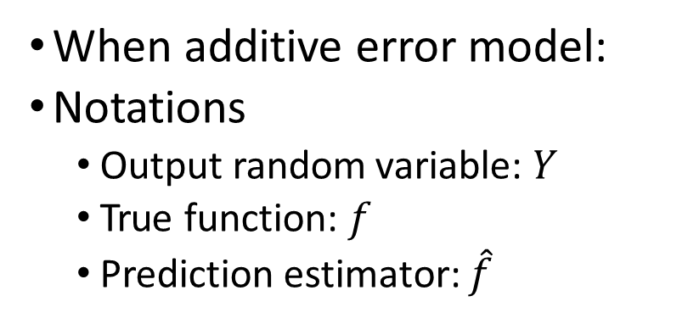
Decomposition of EPE
When additive error model:
Notations
Output random variable: $Y$
True function: $f$
Prediction estimator: $\hat{f}$
N
Irreducible / Bayes error

Slide 14
Derivation

Slide 15
Derivation

Slide 16
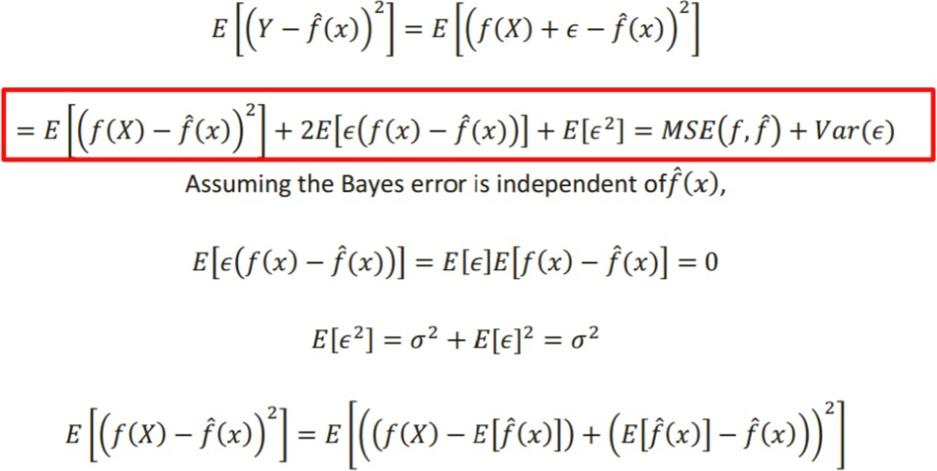
Decomposition of EPE
http://alex.smola.org/teaching/10-701-15/homework/hw3_sol.pdf

Slide 17
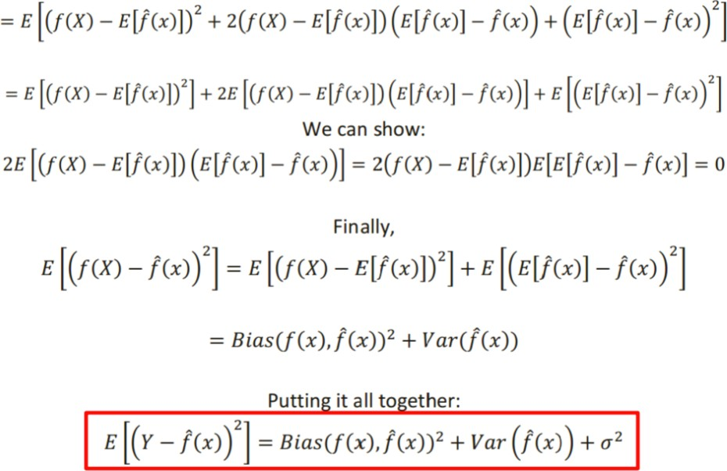
Decomposition of EPE
http://alex.smola.org/teaching/10-701-15/homework/hw3_sol.pdf

Slide 18
Bias-Variance Trade-off for EPE:
EPE (x) = noise² + variance + bias²
Unavoidable error
Error due to variance of training samples
Error due to incorrect assumptions

Slide 19
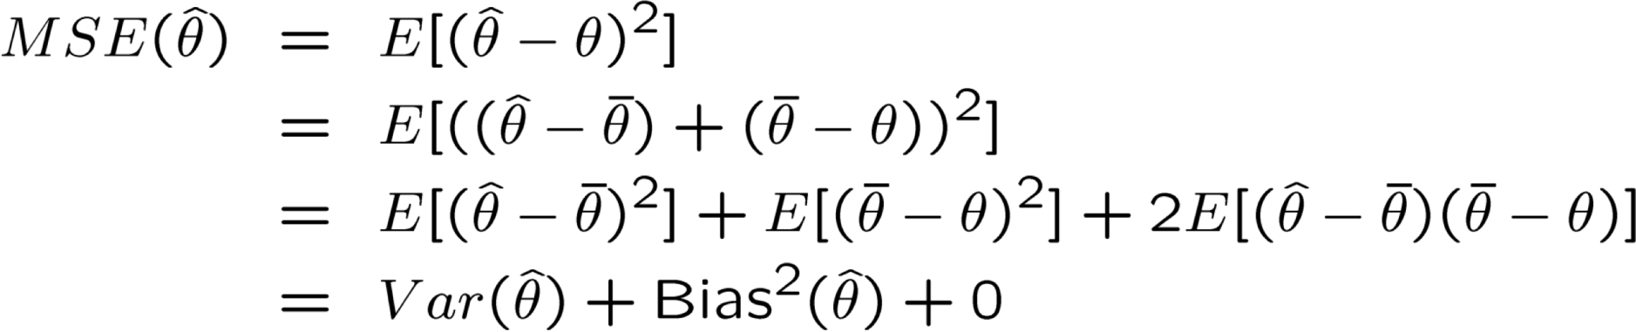

Another View: Bias and Variance Trade-off for parameter estimation
$$E(\hat{θ})=\overline{θ}$$
Error due to variance of training samples
Error due to incorrect assumptions

Slide 20
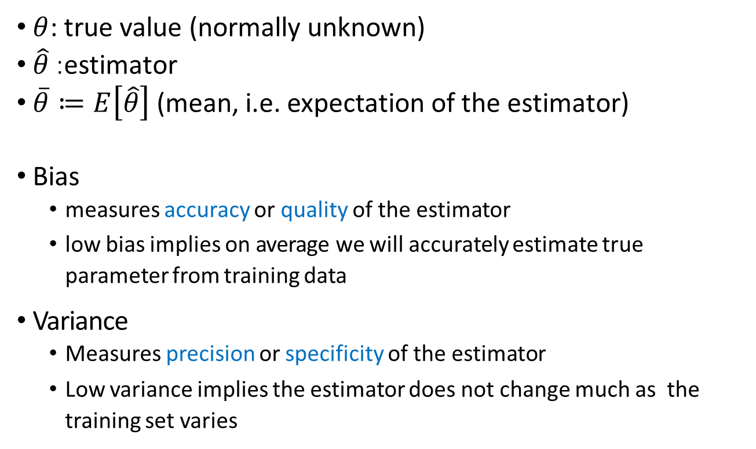


Bias And Variance Trade-off for Parameter Estimation (Extra)
$θ$: true value (normally unknown)
$\hat{θ}$: estimator
$\overline{θ}≔E\left[\hat{θ}\right]$(mean, i.e. expectation of the estimator)
Bias
measures accuracy or quality of the estimator
low bias implies on average we will accurately estimate true parameter from training data
Variance
Measures precision or specificity of the estimator
Low variance implies the estimator does not change much as the training set varies
$$E[(\overline{θ}−θ)]$$
$$E[(\hat{θ}−\overline{θ})^{2}]$$
Notes:
1

Slide 21
Today
Bias-variance decomposition
Bias-Variance Tradeoff / Model Selection

Slide 22
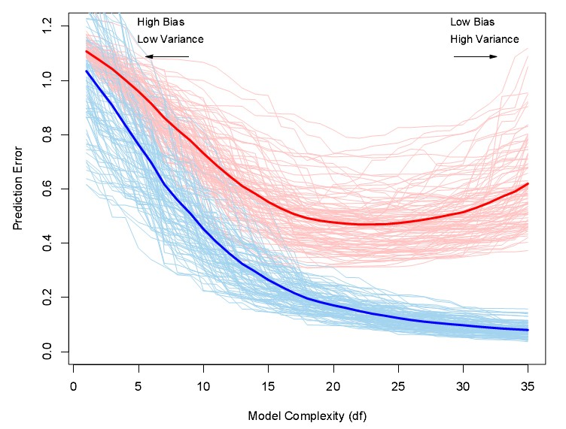
(1) Randomness of Training Sets
Expected test error
Expected training error

Slide 23
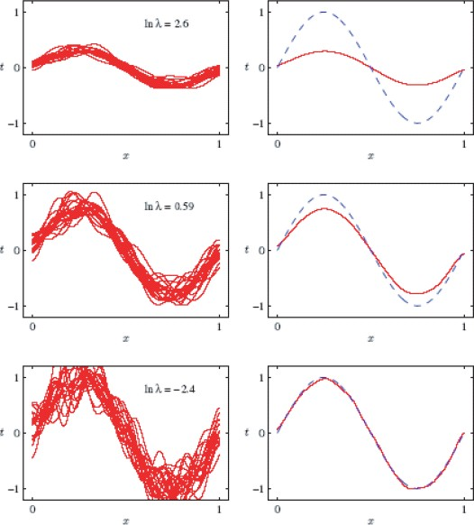
Bias-variance tradeoff
e.g. Regularized LR as an example.
λ is a "regularization" terms in LR. The smaller the λ, is more complex the model. But why?
Simple (highly regularized) models have low variance but high bias.
Complex models have low bias but high variance.
You are inspecting an empirical average over 100 training set.

Slide 24
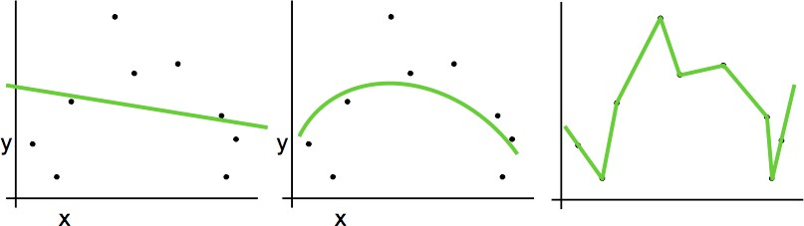






Randomness of Train Set => Variance of Models, e.g.,
eg. removing one training sample
$$\hat{θ_{1}}$$
$$\hat{θ_{2}}$$
$$\hat{θ_{2}}$$
$$\hat{θ_{2}}$$
$$\hat{θ_{1}}$$
$$\hat{θ_{1}}$$

Slide 25
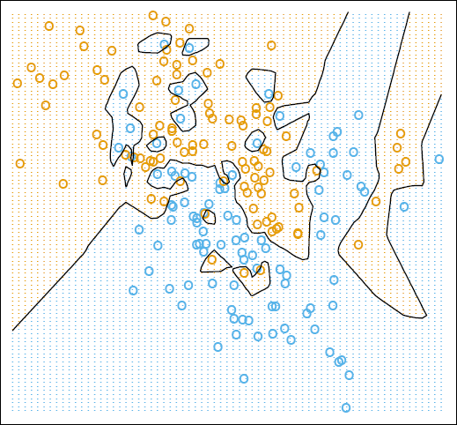
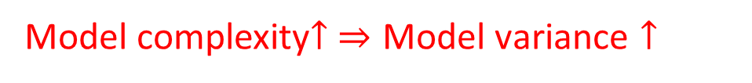
Randomness of Train Set => Variance of Models, e.g.,
K = 15
eg. adding one train sample
K = 1
no change of decision boundary
decision boundary changed
Model complexity$↑ ⇒\text{Model} \text{variance}↑$

Slide 26
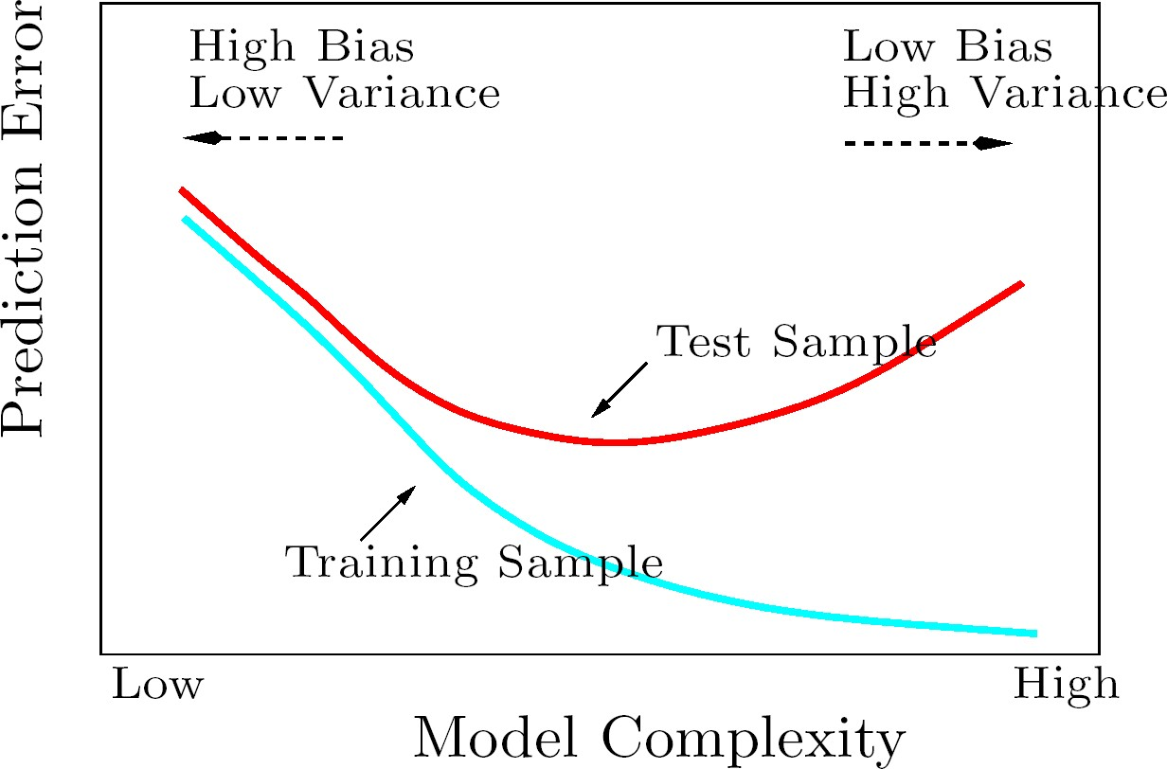
Bias-Variance Tradeoff / Model Selection
underfit region
overfit region

Slide 27
Bias-Variance Trade-off
Models with too few parameters are inaccurate because of a large bias (not enough flexibility).
Models with too many parameters are inaccurate because of a large variance (too much sensitivity to the sample randomness).

Slide 28
Bias-Variance Tradeoff / Model Selection
cv/test error
[good approximation of EPE]
underfit region
overfit region
KNN: large K
Regression: small d
small K
large d

Slide 29
Regression: Complexity versus Goodness of Fit
Low Variance
/ High Bias
Low Bias
/ High Variance
Highest Bias Lowest variance
Model complexity = low
Medium Bias Medium Variance
Model complexity = medium
Smallest Bias Highest variance
Model complexity = high

Slide 30
Classification, Decision boundaries in global vs. local models
K = 15
K = 1
15-nearest neighbor
1-nearest neighbor
Low Variance
/ High Bias
Low Bias
/ High Variance
Highest Bias Lowest variance
Model complexity = low
Medium Bias Medium Variance
Model complexity = medium
Smallest Bias Highest variance
Model complexity = high

Slide 31
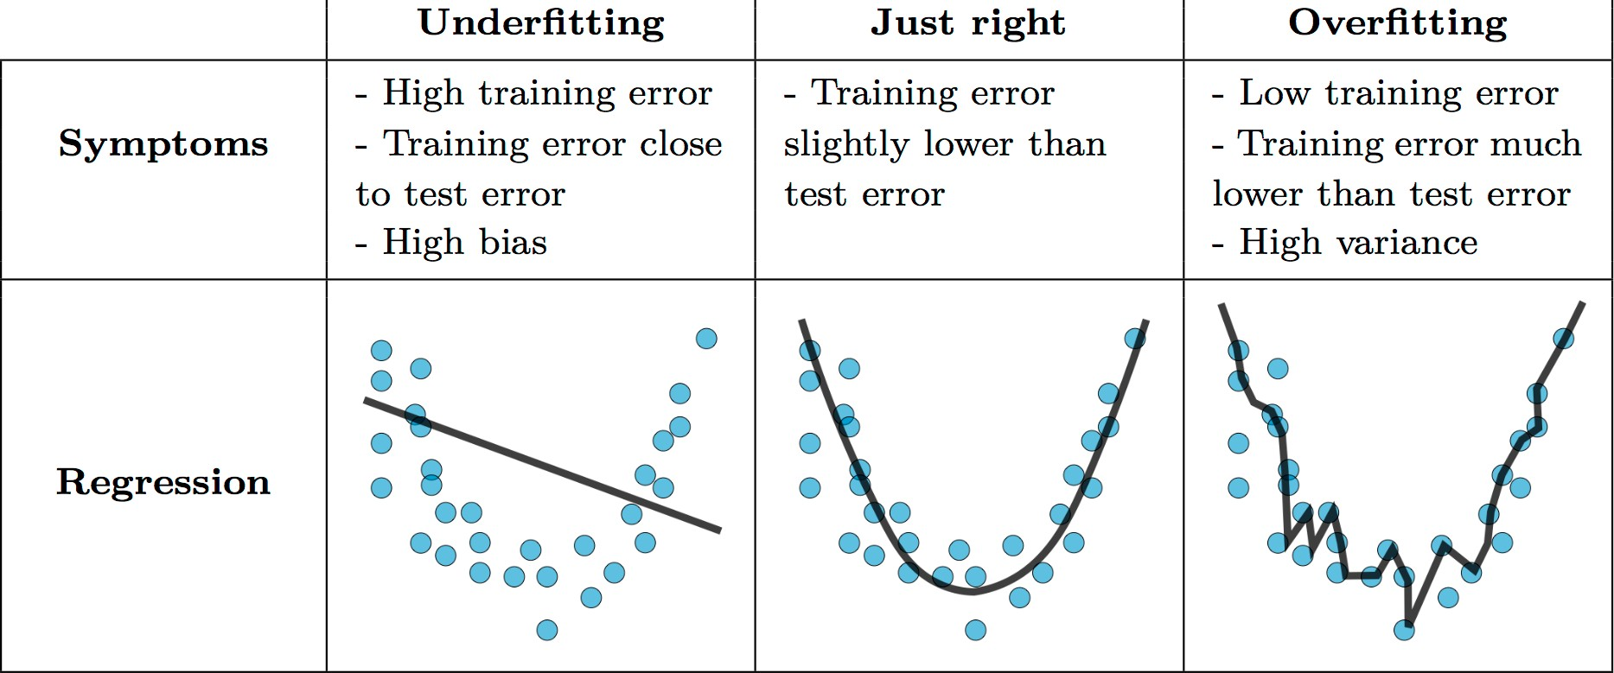
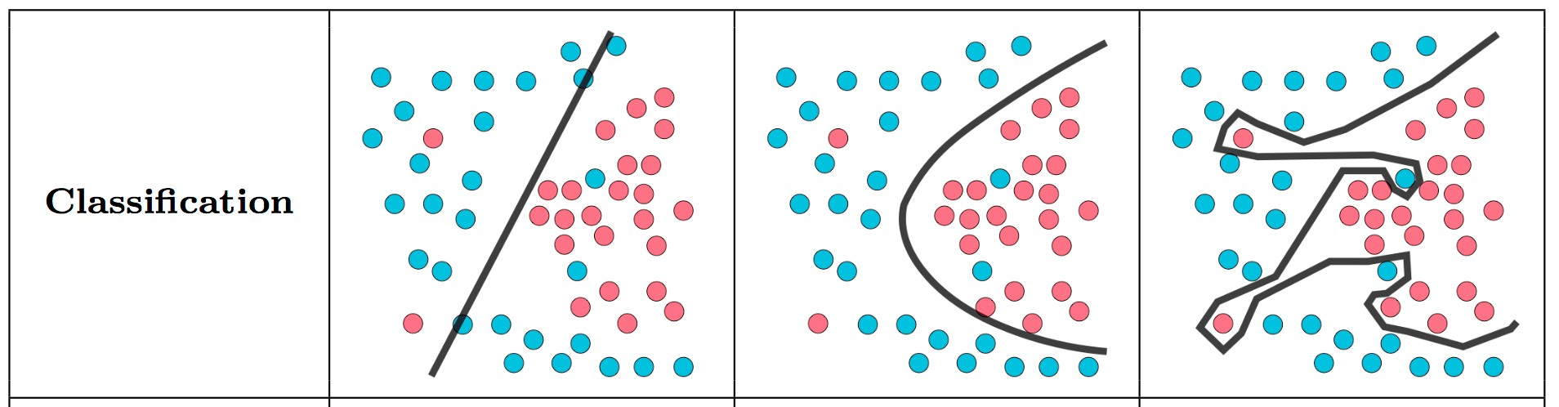
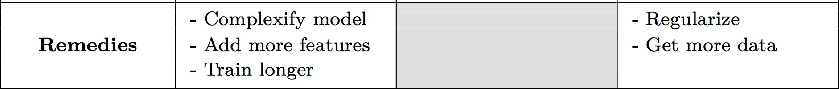
- Select feature
Credit: Stanford Machine Learning

Slide 32
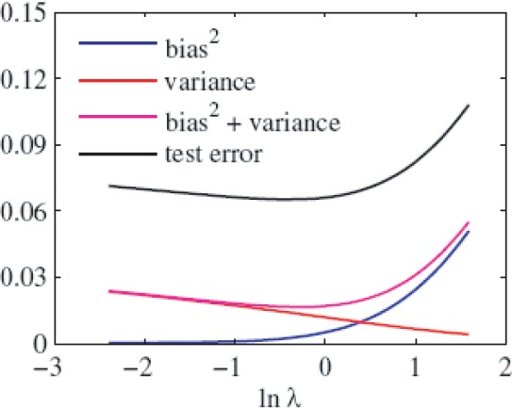
Bias² + variance / Model Selection?
Bias²+variance predicts (shape of) test error quite well.
However, bias and variance cannot be computed since it relies on knowing the true distribution of x and y

Slide 33
References
https://qiyanjun.github.io/2019f-UVA-CS6316-MachineLearning/

Slide 34
The battle against overfitting (Extra) :
Cross validation
Regularization
Feature selection
Model selection -- Occam's razor
Model averaging
The Bayesian-frequentist debate
Bayesian learning (weight models by their posterior probabilities)

Slide 35
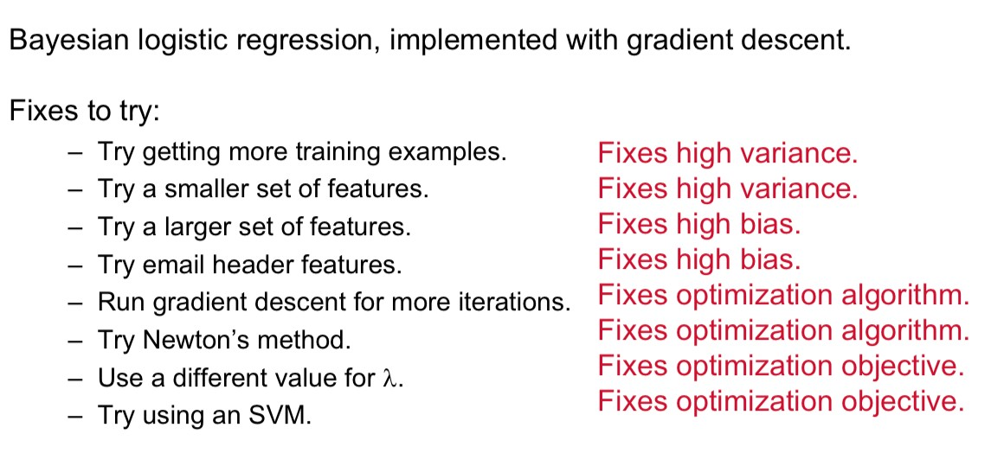
For instance, if trying to solve ‘spam detection’ using (Extra)
L2 -
If performance is not as desired
Slide credit: A. Ng

Slide 36
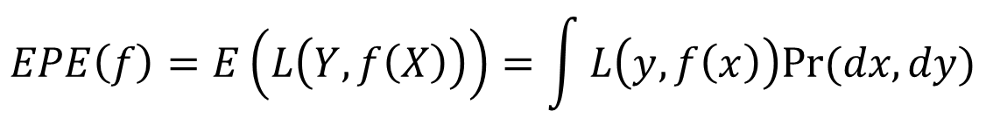

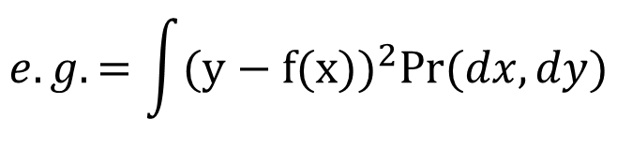
Expected prediction error (EPE)
Consider joint distribution
$$EPE\left(f\right)=E\left(L\left(Y,f\left(X\right)\right)\right)=\int{L\left(y,f\left(x\right)\right)Pr⁡(dx,dy)}$$
$$e.g.=\int{(y−f(x))^{2}Pr⁡(dx,dy)}$$
For L2 loss:
under L2 loss, best estimator for EPE (Theoretically) is :
Conditional mean
$$\hat{f}\left(x\right)=E(Y|X=x)$$
e.g. KNN
NN methods are the direct implementation (approximation )
Notes:
1，这页的字体统一一下，排版再规整一点，不要黄色高亮，对话框和里面的文字都为黑色

Slide 37
kNN for minimizing EPE
We know under L2 loss, best estimator for minimize EPE (theoretically) is :
Conditional
mean
f (x) = E(Y | X = x)
Nearest neighbours assumes that f(x) is well approximated by a locally constant function.

Slide 38



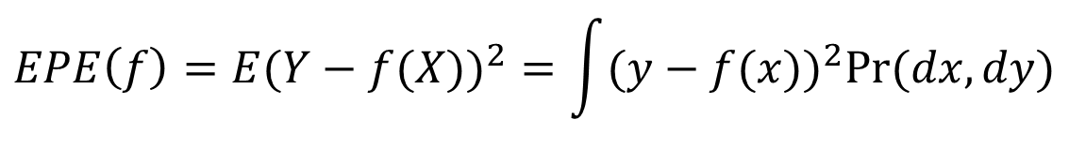
Minimize EPE using L2
Expected prediction error (EPE) for L2 Loss:
Since Pr(X,Y )=Pr(Y |X )Pr(X ), EPE can also be written as
Thus it suffices to minimize EPE pointwise
$$EPE\left(f\right)=E(Y−f(X))^{2}=\int{(y−f(x))^{2}Pr⁡(dx,dy)}$$
$$EPE\left(f\right)=E_{X}E_{Y|X}([Y−f(x)]^{2}|X)$$
Best estimator under L2 loss: conditional expectation
$$f\left(x\right)=argmin_{c}E_{Y|X}([Y−c]^{2}|X=x)$$
Conditional mean
Solution for Regression:
$$f\left(x\right)=E(Y|X=x)$$
Solution for kNN:
Notes:
1，这页的排版再规整一下，第一缩进的位置调整调整，字体大小再调整调整

Slide 39
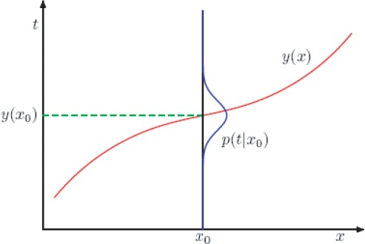
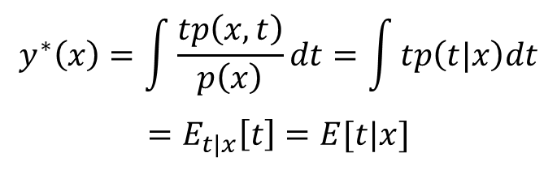
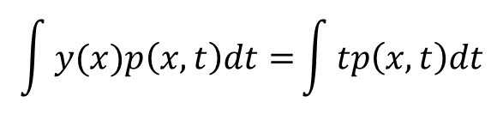
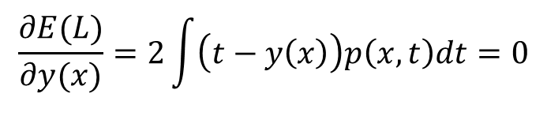
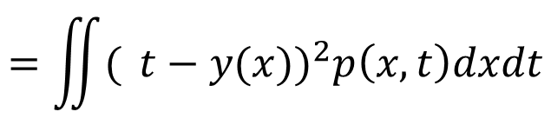
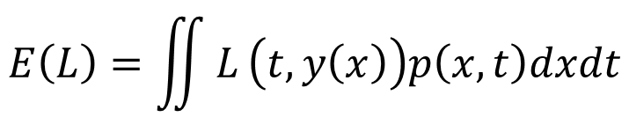
Minimize EPE using L2 (another proof)
Let t be the true (target) output and y(x) be our estimate. The expected squared loss is
Our goal is to choose y(x) that minimize E(L):
Calculus of variations:
$$E\left(L\right)=\iint{L}\left(t,y\left(x\right)\right)p\left(x,t\right)dxdt$$
$$=\iint{( }t−y(x))^{2}p\left(x,t\right)dxdt$$
$$\frac{∂E(L)}{∂y(x)}=2\int{\left(t−y\left(x\right)\right)p\left(x,t\right)dt=0}$$
$$\int{y(x)p\left(x,t\right)dt=}\int{tp\left(x,t\right)dt}$$
$$y^{∗}\left(x\right)=\int{\frac{tp\left(x,t\right)}{p\left(x\right)}}dt=\int{tp\left(t|x\right)dt}$$
$$=E_{t|x}\left[t\right]=E[t|x]$$
Notes:
1

Slide 40








Review: EPE with different loss
Loss Function | Estimator
L₂
L₁
0-1 | (Bayes classifier / MAP)

Slide 41
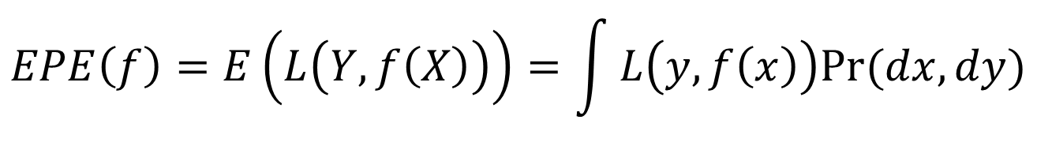



Expected prediction error (EPE)
Consider joint distribution
$$EPE\left(f\right)=E\left(L\left(Y,f\left(X\right)\right)\right)=\int{L\left(y,f\left(x\right)\right)Pr⁡(dx,dy)}$$
For 0-1 loss:
$$L\left(k,l\right)=1−d_{kl}$$
$$\hat{f}\left(X\right)=C_{k}if$$
Bayes Classifier
$$\operatorname{Pr}\left(C_{k} | X=x\right)={}_{g∈C}^{max}{Pr⁡(g|X=x})$$
Notes:
同34页

Slide 42
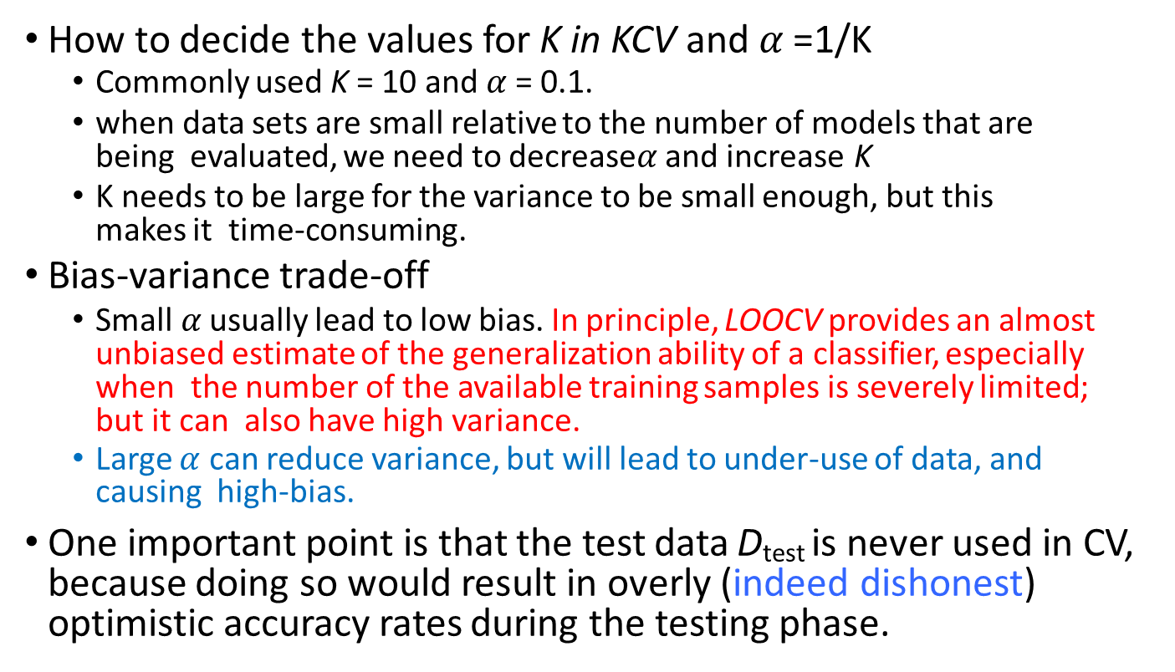
Practical issues for CV
How to decide the values for K in KCV and $α$ =1/K
Commonly used K = 10 and $α$= 0.1.
when data sets are small relative to the number of models that are being evaluated, we need to decrease$α$ and increase K
K needs to be large for the variance to be small enough, but this makes it time-consuming.
Bias-variance trade-off
Small$α$ usually lead to low bias. In principle, LOOCV provides an almost unbiased estimate of the generalization ability of a classifier, especially when the number of the available training samples is severely limited; but it can also have high variance.
Large $α$ can reduce variance, but will lead to under-use of data, and causing high-bias.
One important point is that the test data D_{test} is never used in CV, because doing so would result in overly (indeed dishonest) optimistic accuracy rates during the testing phase.

Slide 43
Thanks for listening

